Slide 1


Todd Wilcox
Jan 23, 2024

Slide 2

Outline
Executive Summary
Introduction
Methodology
Results
Conclusion
Appendix

Slide 3
Executive Summary
Methodology Summary:
Data was gathered from SpaceX APIs and Wikipedia tables
Data was cleansed and normalized (null value cleanup, StandardScalar, One-Hot Encoding)
Exploratory Data Analysis was done visually through Plotly and through SQL Queries
A variety of model building techniques were used to find the most suitable approach
The data set of landings is limited with under 100 records. While that is not a large sample, it was enough to allow our models to be accurate with scores of 0.833
Despite all models trained on the training data performing equally well on the test data, the Support Vector Machine model was slightly more accurate when rebuilt using the full set of data, achieving a score of 0.877 with only 4 False Positives

Slide 4
Introduction
SpaceX is an American aerospace manufacturer and space transportation company founded by Elon Musk in 2002. Known for its ambitious goals of reducing space transportation costs, SpaceX has achieved numerous milestones, including the development of the Falcon and Starship rockets
The Falcon 9, a key player in SpaceX's fleet, is a two-stage rocket designed for the reliable and safe transport of satellites and the Dragon spacecraft into orbit. It features reusability, with the first stage capable of returning to Earth for refurbishment and reuse in multiple launches.
The overall cost of a launch is about $62 million if the first stage can be re-used, but nearly $165MM if it cannot.
This analysis looks to predict the likelihood or first stage re-use by evaluating past launches and the whether the first stage was recovered for future use. The following drivers are analyzed in the analysis:
Launch Date
Payload Mass
Launch Site
Orbit
Booster Version
Landing Pad

Slide 5

Section 1

Slide 6
Methodology
Executive Summary
Data collection methodology:
Data was gathered from two sources, the SpaceX API and the SpaceX Wikipedia Page
Perform data wrangling
Landing success was simplified, Missing Payload Mass data was assigned and categorical fields were re-mapped to enable successful modeling
Perform exploratory data analysis (EDA) using visualization and SQL
Perform interactive visual analytics using Folium and Plotly Dash
Perform predictive analysis using classification models
Four different modeling techniques (Logistic Regression, Support Vector Machine, Decision Trees and K Nearest Neighbor were evaluated to determine the most predictive

Slide 7
Data Collection
Data collection started by using the requests and pandas libraries to turn data from several SpaceX REST APIs into Pandas Dataframes
spacex_url=https://api.spacexdata.com/v4/launches/past
Using the data from this API, we can then use several other REST API sites to get more detail on rockets, launchpads, payloads and rocket cores
The Beautiful Soup library was then used to parse an HTML table of SpaceX launch information from Wikipedia page.
Once extracted, the data was moved into Pandas Dataframes and csv files for future use

Slide 8
Data Collection – SpaceX API
Main API
The main SpaceX API site provides basic information and keys that can be used to gather more detailed information: https://api.spacexdata.com/v4/launches/past
https://api.spacexdata.com/v4/rockets/*
https://api.spacexdata.com/v4/launchpads/*
https://api.spacexdata.com/v4/payloads/*
https://api.spacexdata.com/v4/cores/*
Requests, Pandas and Numpy were used to extract json files and stage the data. Fillna() was used to replace the null values in Payload Mass with the mean mass
Detailed work can be found in: https://github.com/nolimpers/IBM-Class-Capstone/blob/main/Lab%201%20-%20jupyter-labs-spacex-data-collection-api.ipynb
Rockets
Launchpads
Payloads
Cores

Slide 9
Data Collection - Scraping
Requests
Requests was used to extract HTML data from the SpaceX Wikipedia page.
Beautiful Soup was used parse the html.
The find_all functionality enabled the extraction of table rows
Detailed work can be found in: https://github.com/nolimpers/IBM-Class-Capstone/blob/main/Lab%202%20-%20jupyter-labs-webscraping.ipynb
Beautiful Soup
html_parser
Find All
(tr and td)
Pandas (create Dataframe)

Slide 10
Data Wrangling
Data from the API and Web Scraping processes were stored as .csv files, which were loaded into Pandas using the read_csv method.
Fields were searched for null values and found that only LandingPad had nulls (29% of records). These were allowed to remain because that is a true reflection of the data (no Landing Pad was used)
Note: The earlier missing values on Payload Mass had already been corrected.
Launch outcomes (later referred to as ‘Class’) were simplified from 8 values down to a simple 1 = Success, 2 = Failure field.
Detailed work can be found in:
https://github.com/nolimpers/IBM-Class-Capstone/blob/main/Lab%203%20-jupyter-spacex-Data%20wrangling.ipynb

Slide 11
EDA with Data Visualization - Process
A variety of charts were created to explore the data and get a sense for which fields were the most important:
Scatterplots (with colored markers where needed) were used to evaluate the relationship between 2-3 columns at a time, including Payload vs Flight, Launch Site vs Flight, Launch Site vs Payload, Orbit vs Payload, and others
Bar Charts were used to evaluate the success rate of missions by Orbit and Year
The following tab contains a few informative charts, showing:
The Geosynchronous Orbit (GTO) and missions to the International Space Station (ISS) have the most failures
Success Rate of missions has increased significantly over time
Detailed work can be found in : https://github.com/nolimpers/IBM-Class-Capstone/blob/main/Lab%205%20-%20jupyter-labs-eda-dataviz.ipynb.jupyterlite.ipynb

Slide 12
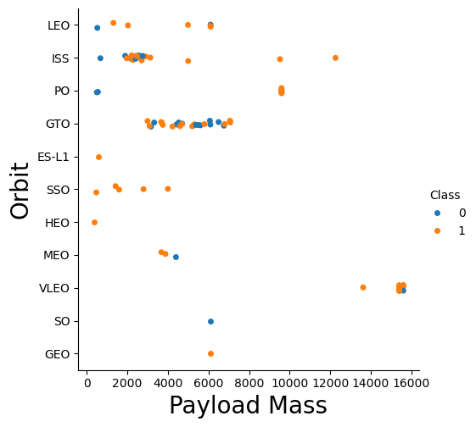
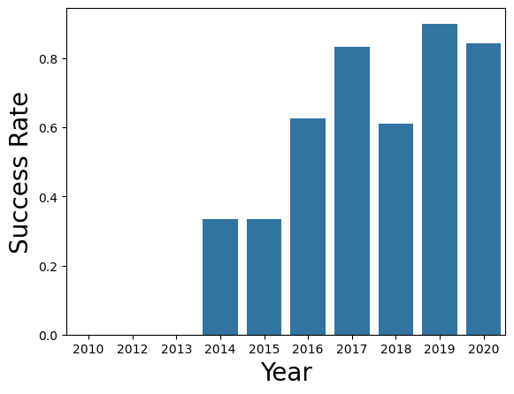
EDA with Data Visualization - Charts

Slide 13
EDA with SQL
Many pieces of investigation were done using SQL queries, including:
Identifying unique Launch Sites
Finding the total Payload Mass associated with NASA (CRS) missions
The average payload mass for F9 v1.1 boosters
The date of the first successful Landing Outcome
Mission Outcome Frequencies
Booster versions that carry the maximum payload
Landing Outcomes (which includes the attempted method, e.g. drone ship, ocean…)
Detailed work can be found in: https://github.com/nolimpers/IBM-Class-Capstone/blob/main/Lab%204%20-%20jupyter-labs-eda-sql-coursera_sqllite.ipynb

Slide 14
Build an Interactive Map with Folium
Folium was used to map the launch site locations to a map of North America. It shows the locations in Florida and California.
Markers for each launch site were added and the Folium MarkerCluster plugin was used to add the launch result to be available interactively for each site.
The MousePosition plugin was used to identify the latitudes and longitudes of nearby areas like oceans, cities and railways. Markers and lines (using the PolyLine) were added to highlight those distances.
Detailed work can be found in: https://github.com/nolimpers/IBM-Class-Capstone/blob/main/Lab%206%20-%20jupyter_launch_site_location.jupyterlite.ipynb

Slide 15
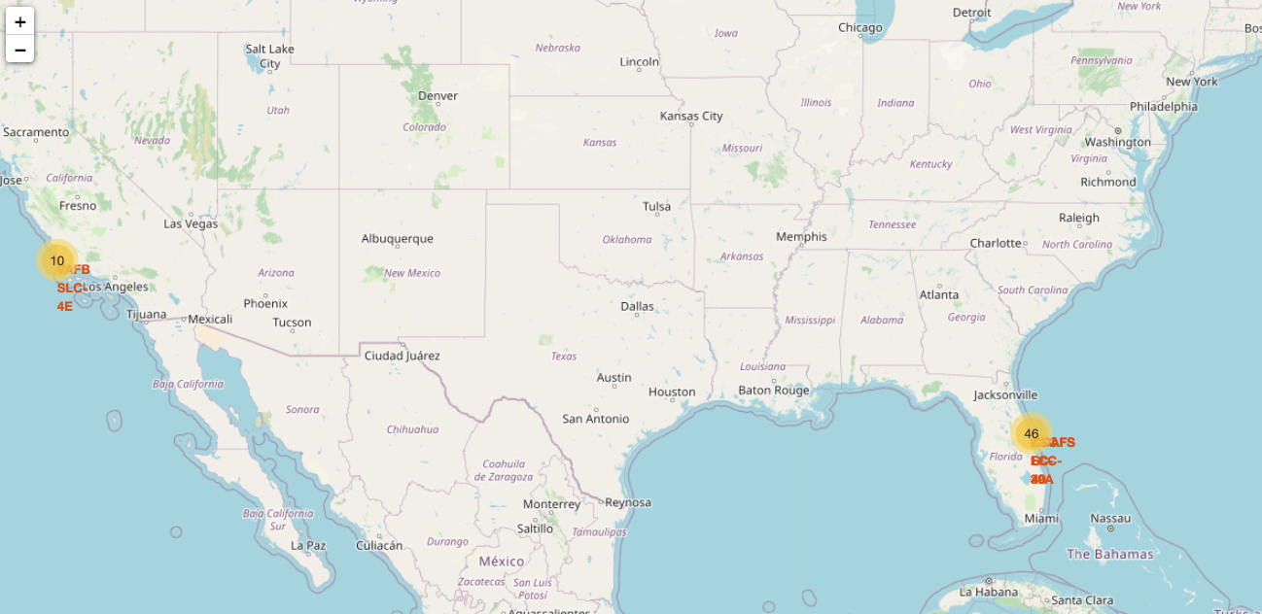
Build an Interactive Map with Folium

Slide 16
Build a Dashboard with Plotly Dash
An interactive dashboard was created using Plotly (for chart creation) and Dash (for interactivity and web hosting). This also involved:
Creating a Launch Site dropdown and Payload Mass Slider for interactive use
Creating Callback functions to link the values in the dropdown and slider to the charts themselves
A pie chart was created so that users can see the Launch Site distribution, and then see the success rate of launches if they choose to drill into a specific site.
A scatter chart was create to show the correlation between payload and launch success, with colored markers to show the Booster Versions.
Detailed code can be found in: https://github.com/nolimpers/IBM-Class-Capstone/blob/main/Interactive%20Dashboard%20Code.py.txt
An image of the dashboard can be found at: https://github.com/nolimpers/IBM-Class-Capstone/blob/main/Plotly%20Interactive%20Dashboard.png

Slide 17
Predictive Analysis (Classification) Part 1
A dataframe that had been one-hot-encoded was combined with a dataframe showing landing success were used for model development and testing.
The numpy function train_test_split was used to create an 80% training sample and 20% testing sample.
The sample was the normalized using Preprocessing and StandardScalar,then placed into a GridSearchDV object.
From there, four different methodologies were used to model the training data and score the test data:
Logistic Regression
Support Vector Machine
Decision Trees
K Nearest Neighbor

Slide 18

Predictive Analysis (Classification) - continued
All four methodologies came up with models with exactly the same score of 0.833.
All four methodologies also sorted the data into the same confusion matrix with 3 records mis-predicted as landing when they actually did not.
To break the tie, when each model was tested on the training population, the Support Vector Machine ended up being the most predictive:
Support Vector Machine: 0.888
Logistic Regression: 0.875
Decision Tree: 0.861
K-Nearest Neighbor: 0.861

Slide 19
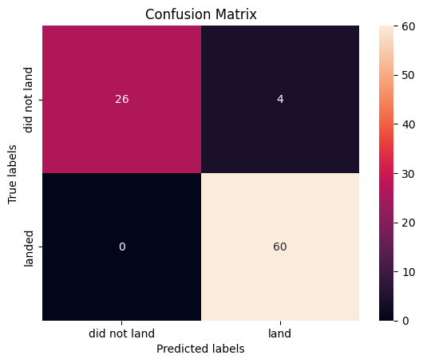
Predictive Analysis (Classification) - continued
Because all 4 methods produced comparable results, all 4 were scored on the whole population.
Again, the Support Vector Machine had the highest score. Interestingly, the kernel changed from sigmoid to linear, though. The confusion also looks improved with only 4 false positives.
SVM Score on whole population: 0.877
Detailed code can be found in: https://github.com/nolimpers/IBM-Class-Capstone/blob/main/Lab%208%20-%20SpaceX_Machine_Learning_Prediction_Part_5.jupyterlite.ipynb

Slide 20

Section 2

Slide 21
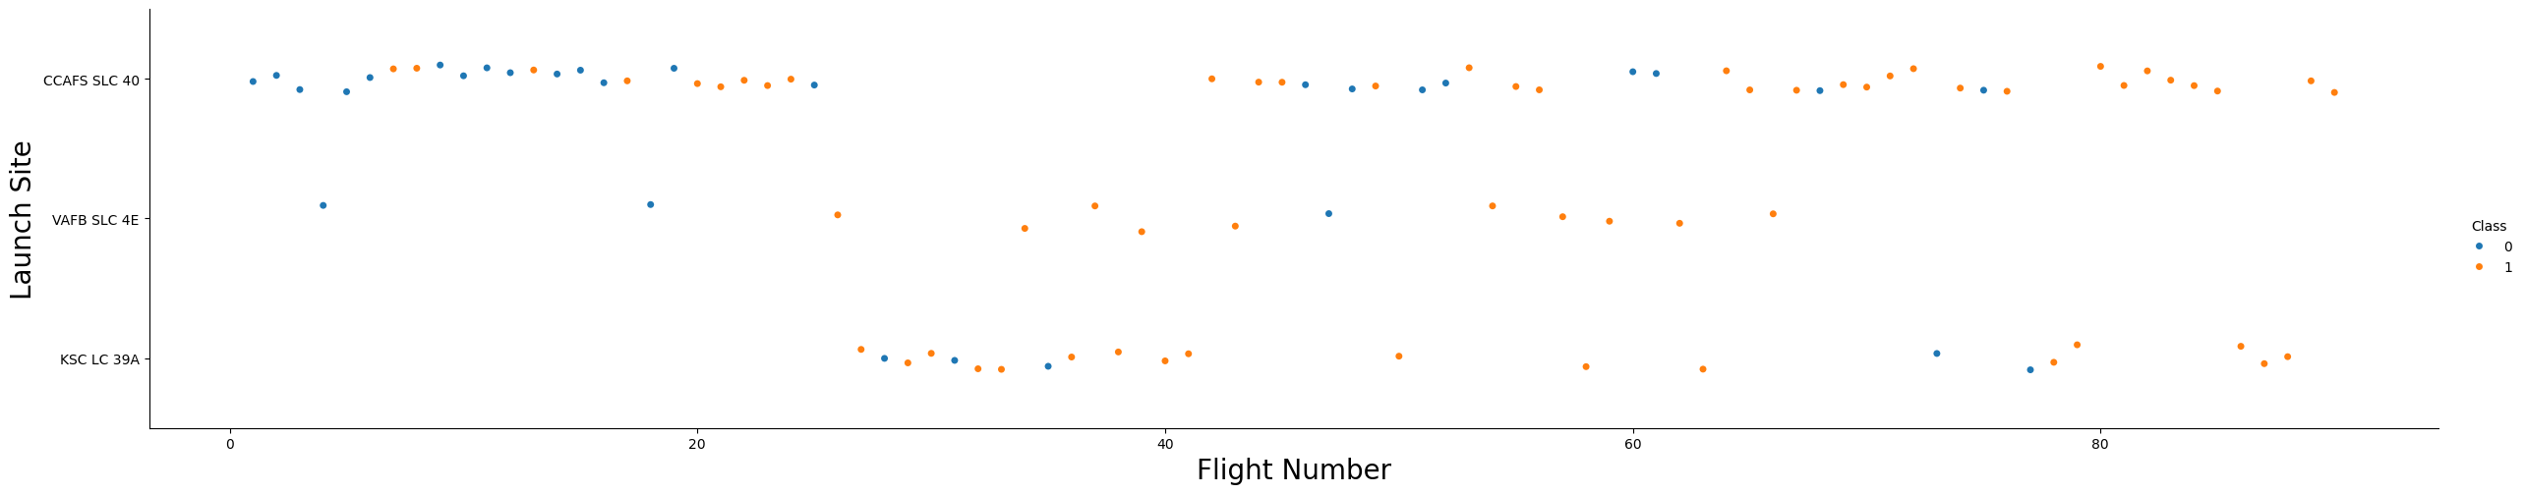
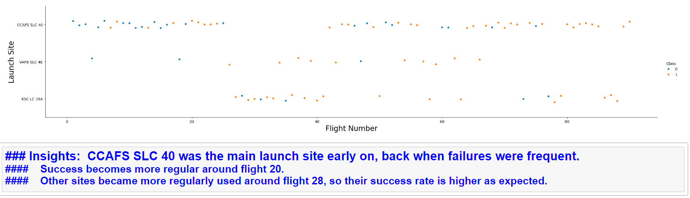
Flight Number vs. Launch Site

Slide 22
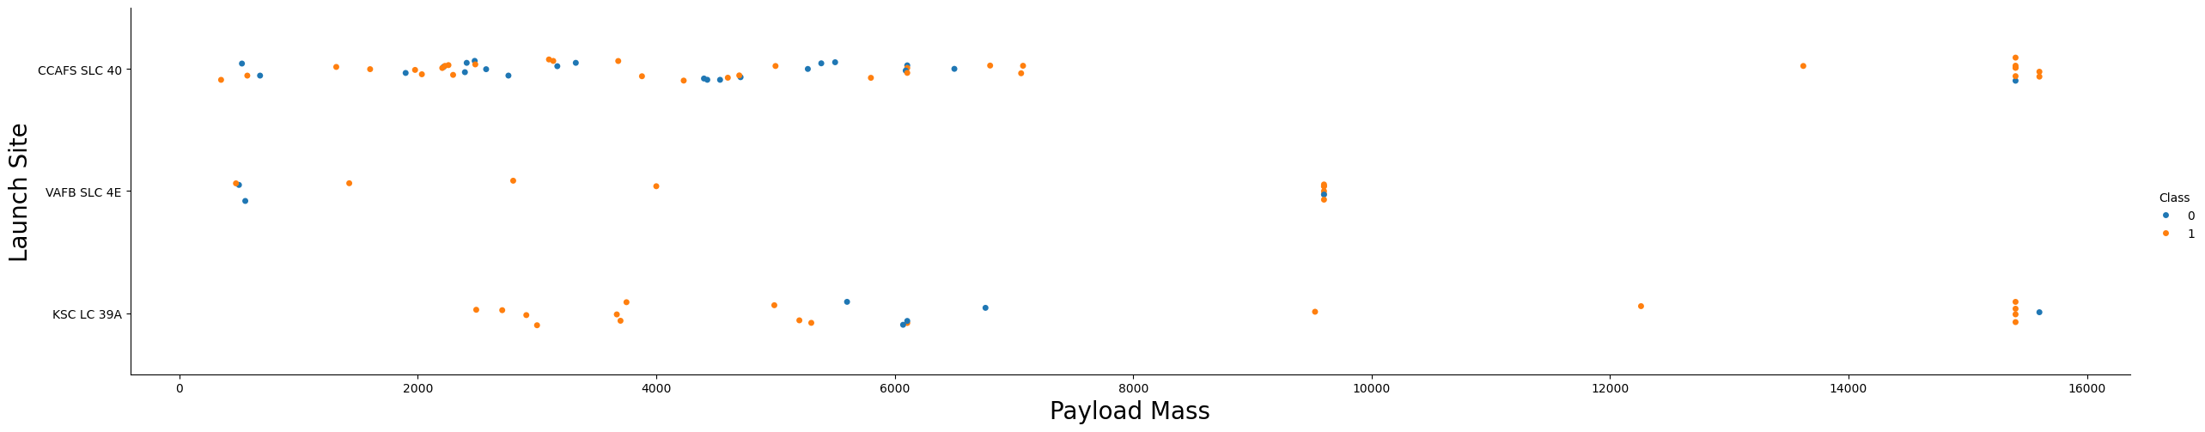
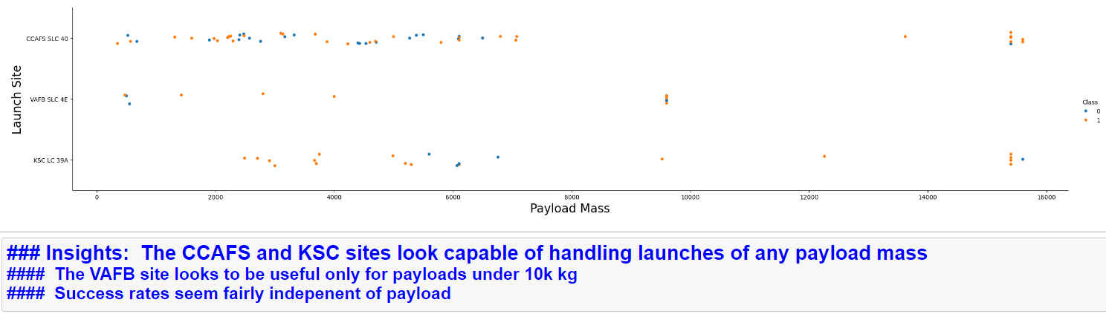
Payload vs. Launch Site

Slide 23
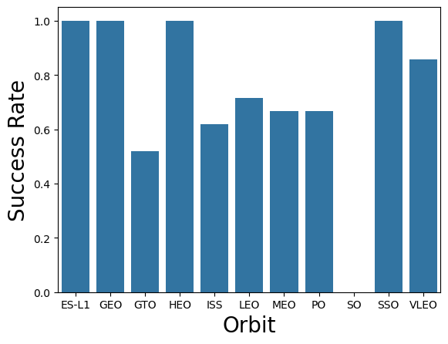
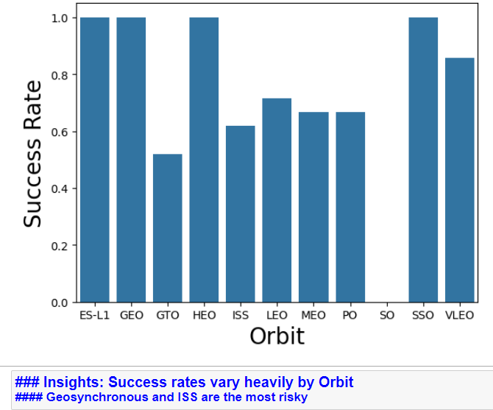
Success Rate vs. Orbit Type

Slide 24
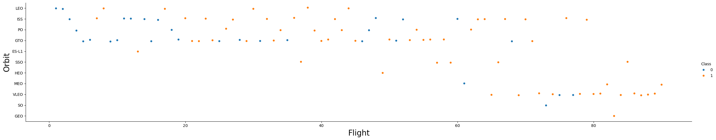
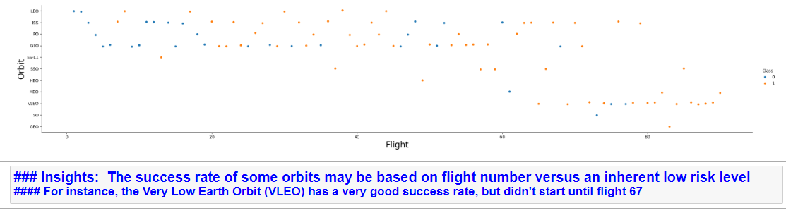
Flight Number vs. Orbit Type

Slide 25
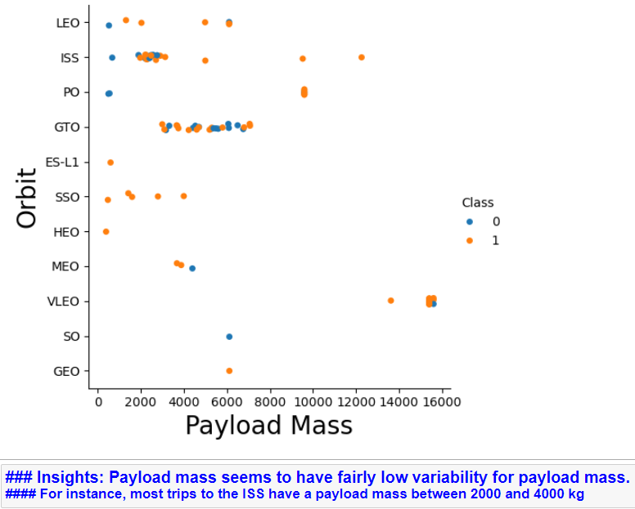
Payload vs. Orbit Type

Slide 26
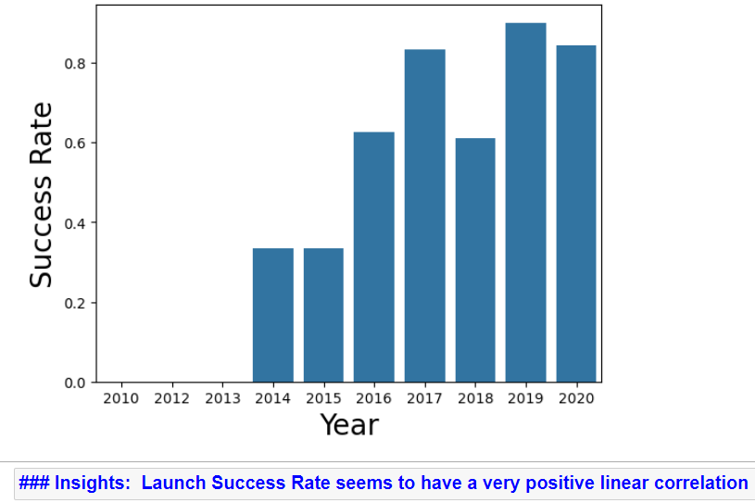
Launch Success Yearly Trend

Slide 27
All Launch Site Names
Find the names of the unique launch sites
%sql select distinct Launch_Site from SPACEXTABLE
%sql – SQL Magic operator to run SQL queries in Jupyter Notebooks
‘distinct’ gives you the unique values

Slide 28
Launch Site Names Begin with 'CCA'
Find 5 records where launch sites begin with `CCA`
%sql select * from SPACEXTABLE where Launch_Site like ('%CCA%') limit 5
The like operator is for pattern matching
The % on either side of the CCA will match to anything (or nothing)
Limit 5 reduces your output to only 5 records
sum(PAYLOAD_MASS__KG_) | count(*)
45596 | 20

Slide 29
Total Payload Mass
Calculate the total payload carried by boosters from NASA (CRS)
%sql select sum(PAYLOAD_MASS__KG_), count(*) from SPACEXTABLE where customer ='NASA (CRS)’
The sum function sums up the values in ()
The count(*) counts the records (not required here but good to see)
The where clause is needed limit the records to NASA (CRS) records
sum(PAYLOAD_MASS__KG_) | count(*)
45596 | 20

Slide 30
Average Payload Mass by F9 v1.1
Calculate the average payload mass carried by booster version F9 v1.1
%sql select avg(PAYLOAD_MASS__KG_) from SPACEXTABLE where Booster_Version ='F9 v1.1’
The avg function finds the mean of the field in the ()
avg(PAYLOAD_MASS__KG_)
2928.4

Slide 31
First Successful Ground Landing Date
Find the dates of the first successful landing outcome on ground pad
%sql select min(date) from SPACEXTABLE where Landing_Outcome like ('%Success%’)
The min function finds the lowest value for the date field
Landing Outcome has a lot of different values that show success, and they all have the word Success in them, so a like function is used to find them all
min(date)
2015-12-22

Slide 32
Successful Drone Ship Landing with Payload between 4000 and 6000
List the names of boosters which have successfully landed on drone ship and had payload mass greater than 4000 but less than 6000
%sql select distinct Booster_Version from SPACEXTABLE where PAYLOAD_MASS__KG_ > 4000 and PAYLOAD_MASS__KG_<6000 and Landing_Outcome='Success (drone ship)’
There isn’t much new here except that I’m using a payload > 4000 and < 6000 combo (which could be done as a BETWEEN in some SQL platforms)
Booster_Version
F9 FT B1022
F9 FT B1026
F9 FT B1021.2
F9 FT B1031.2

Slide 33
Total Number of Successful and Failure Mission Outcomes
Calculate the total number of successful and failure mission outcomes
%sql select Mission_Outcome, count(*) from SPACEXTBL group by 1 order by 1
We have our first group by here, which is needed when using aggregate functions.
We have our first order by here which sorts the records in ascending order
Both clauses make use of ‘1’ (group by 1 order by 1), which is a shortcut for saying the first field from the select list
Mission_Outcome | count(*)
Failure (in flight) | 1
Success | 98
Success | 1
Success (payload status unclear) | 1

Slide 34
Boosters Carried Maximum Payload
List the names of the booster which have carried the maximum payload mass
%sql select distinct Booster_Version from SPACEXTBL where PAYLOAD_MASS__KG_ in
(select max(PAYLOAD_MASS__KG_) from SPACEXTBL)
This query needs to be done with a subquery – the subquery finds the maximum value of the payload
Then the result of that subquery is used in an “in” clause, which could have been an equal here as an alternative. “In” is usually used for a list of items.
Booster_Version
F9 B5 B1048.4
F9 B5 B1049.4
F9 B5 B1051.3
F9 B5 B1056.4
F9 B5 B1048.5
F9 B5 B1051.4
F9 B5 B1049.5
F9 B5 B1060.2
F9 B5 B1058.3
F9 B5 B1051.6
F9 B5 B1060.3
F9 B5 B1049.7

Slide 35
2015 Launch Records
List the failed landing_outcomes in drone ship, their booster versions, and launch site names for in year 2015
%sql select substr(Date,6,2) as mth, Landing_Outcome, Booster_Version, Launch_Site from SPACEXTBL where Landing_Outcome='Failure (drone ship)’ and substr(Date,0,5)='2015’
The substring function is used twice here. That function is like slicing a string, in this case parsing out a date in YYYY-MM-DD format into:
The 6th and 7th bytes (Month) (start at byte 6 and take 2 bytes)
Bytes 0-4 (Year) – start at byte 0 and take 5 bytes (this was recommended by the class – I would normally do substr(1,4).
mth | Landing_Outcome | Booster_Version | Launch_Site
01 | Failure (drone ship) | F9 v1.1 B1012 | CCAFS LC-40
04 | Failure (drone ship) | F9 v1.1 B1015 | CCAFS LC-40

Slide 36
Rank Landing Outcomes Between 2010-06-04 and 2017-03-20
Rank the count of landing outcomes (such as Failure (drone ship) or Success (ground pad)) between the date 2010-06-04 and 2017-03-20, in descending order
%sql select Landing_Outcome, count(*) from SPACEXTBL where Date >= '2010-06-04' and Date <= '2017-03-20’ group by 1 order by 2 desc
The only new item here is the use of desc to note that the sort should be in descending order. In this case, it is on the count field, so it shows the largest values at the top
Landing_Outcome | count(*)
No attempt | 10
Success (drone ship) | 5
Failure (drone ship) | 5
Success (ground pad) | 3
Controlled (ocean) | 3
Uncontrolled (ocean) | 2
Failure (parachute) | 2
Precluded (drone ship) | 1

Slide 37

Section 3

Slide 38

SpaceX Launch Sites
Markers have been added at the launch sites

Slide 39
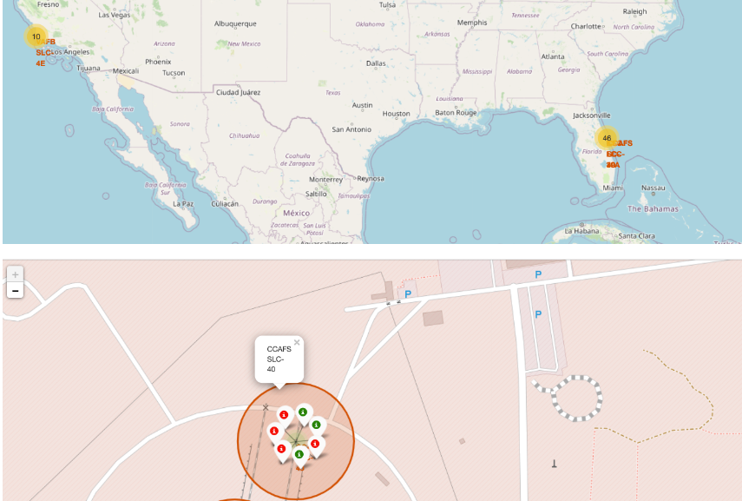
<Folium Map Screenshot 2>
The Yellow groupings are the clusters assigned to each launch site.
When you zoom in and click on a cluster, it will show a circular set of green (success) and red(failure) values for each launch from there

Slide 40
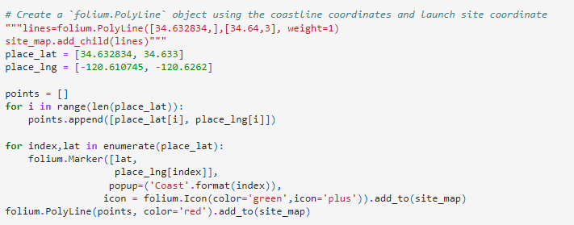
<Folium Map Screenshot 3>
Sorry, my maps didn’t come along with my notebooks when I saved them. But I had a map of a California launch site showing a line of 1.9km to the shore, using this code:

Slide 41

Section 4

Slide 42
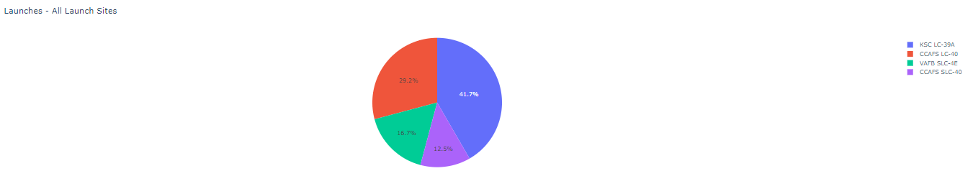
Launch Success by Launch Site
The pie chart shows the share of launches from each site. This is the option that appears when the dropdown box selects All Sites

Slide 43
<Dashboard Screenshot 2>
Sorry, my maps didn’t come along with my notebooks when I saved them. But I had a map of a California launch site showing a line of 1.9km to the shore, using this code:
But what happened on the interactive dashboard was that a selection in the dropdown box of any of the individual sites would change the pie chart from a “count by site” into a Success vs Failure pie chart.

Slide 44
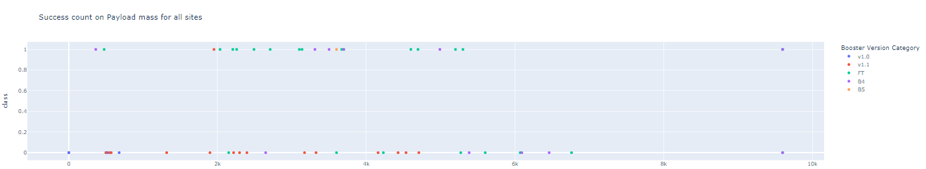
Success Count by Payload Mass for All Sites
The successful launches are at the top of the chart (Class = 1)
The failed launches are at the bottom of the chart (Class = 0)
The colors signify the Booster Version of the Falcon 9 Rocket

Slide 45

Section 5

Slide 46
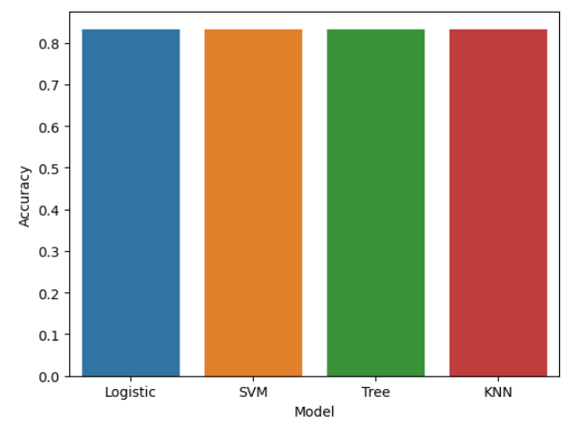
Classification Accuracy
As you can see, all four models scored exactly the same (0.833) when modeling the SpaceX data.

Slide 47
Confusion Matrix
The Confusion Matrix for all 4 models is also identical.
For all 12 actual landings, all 12 were correctly predicted.
For the 6 failed landings, the models got 3 correct and got 3 wrong.
This would be a False Negative problem.

Slide 48
Conclusions
The data set of landings is limited with under 100 records. While that is not a large sample, it was enough to allow our models to be accurate with scores of 0.833
Despite all models trained on the training data performing equally well on the test data, the Support Vector Machine model was slightly more accurate when rebuilt using the full set of data, achieving a score of 0.877 with only 4 False Positives.
Through exploratory data analysis, it is clear that Launch Number (or Date) plays a major role in the success or failure. Early launches rarely succeeded, while later launches are succeeding at a rate of nearly 90%
For a competitor to enter the market, the early failure of SpaceX landing may be more indicative of early results for a competitor. So, the pricing of early launches will be closer to $165MM before success becomes regular, leading to the re-use of the Falcon 9 Rocket

Slide 49
Appendix
All project elements can be found at:
https://github.com/nolimpers/IBM-Class-Capstone/tree/main

Slide 50


